Slide 1




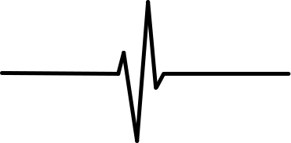

Health Disease
Diagnosis
An analytic and predictive approach

Slide 2
Introduction:
With the increasing environmental changes and rapid evolution, human bodies have become more prone and sensitive to deadly diseases than before.
Cardiovascular disease refers to any disease that affects the cardiovascular system, including coronary heart disease, myocardial infarction or heart attack, stroke or cerebrovascular accident (CVA), vascular diseases, and/or peripheral arterial diseases.
One person dies every 33 seconds from a cardiac disease.
This increases the necessity to stop feigning ignorance and detect the disease to aid its diagnosis.

Slide 3
Objective:
The aim of this data science project focuses on determining the various health-related factors that are direct or indirect reasons for the increasing numbers of heart patients.
By establishing relations between various attributes, the project also provides a model that serves to detect heart diseases, which in turn can reduce the number of cases by predicting them in their early stages

Slide 4
Main KPI’s:
KPI stands for key performance indicator, a quantifiable measure of performance over time for a specific objective.
In this dataset, exploratory data analysis and accurate models provided top five determining KPI’s. They are
chest pain type (cp),
number of major vessels (ca)
maximum heart rate achieved during stress test (thalach)
ST depression induced by exercise (oldpeak)
thalium stress result (thal)

Slide 5
Process:
Model Training and
Fitting
Data Acquisition
Hyper-parameter tuning
Exploratory Data Analysis
Testing

Slide 6
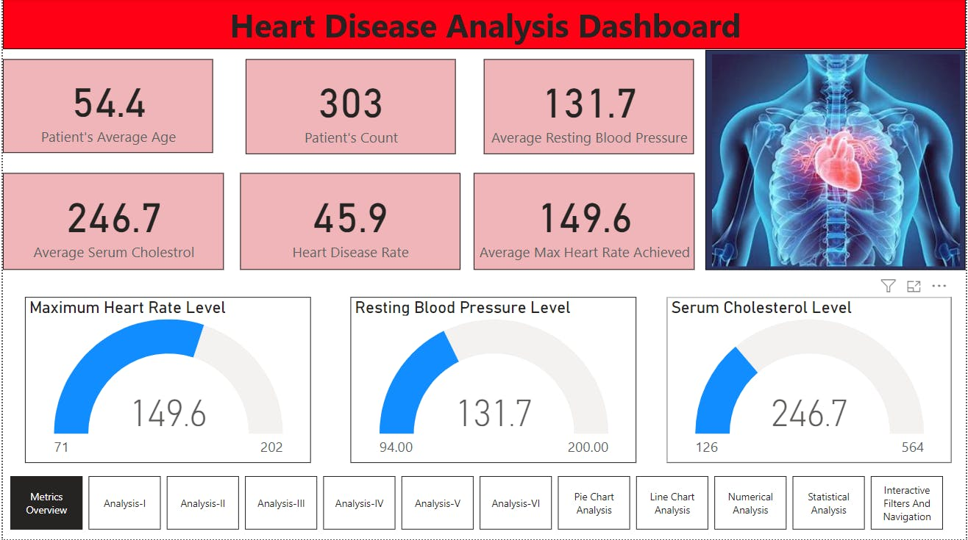
Mock Dashboard

Slide 7
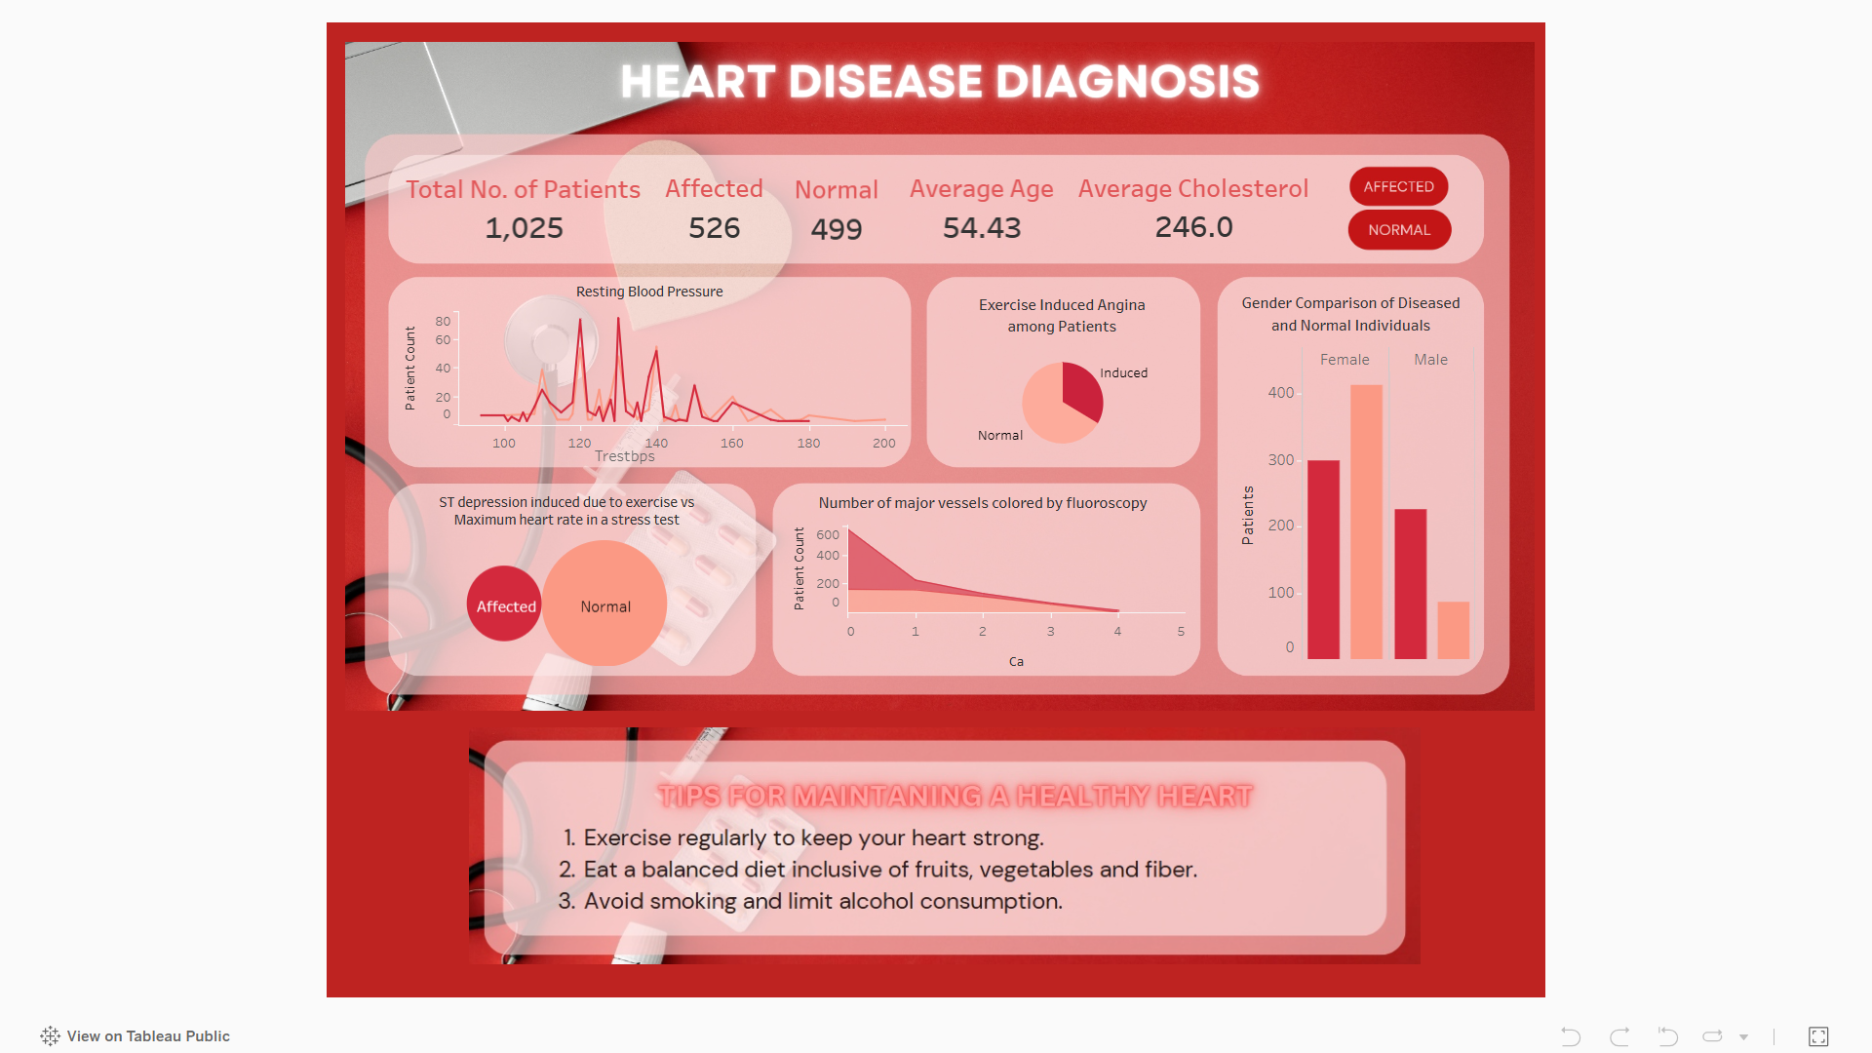
My Dashboard:

Slide 8
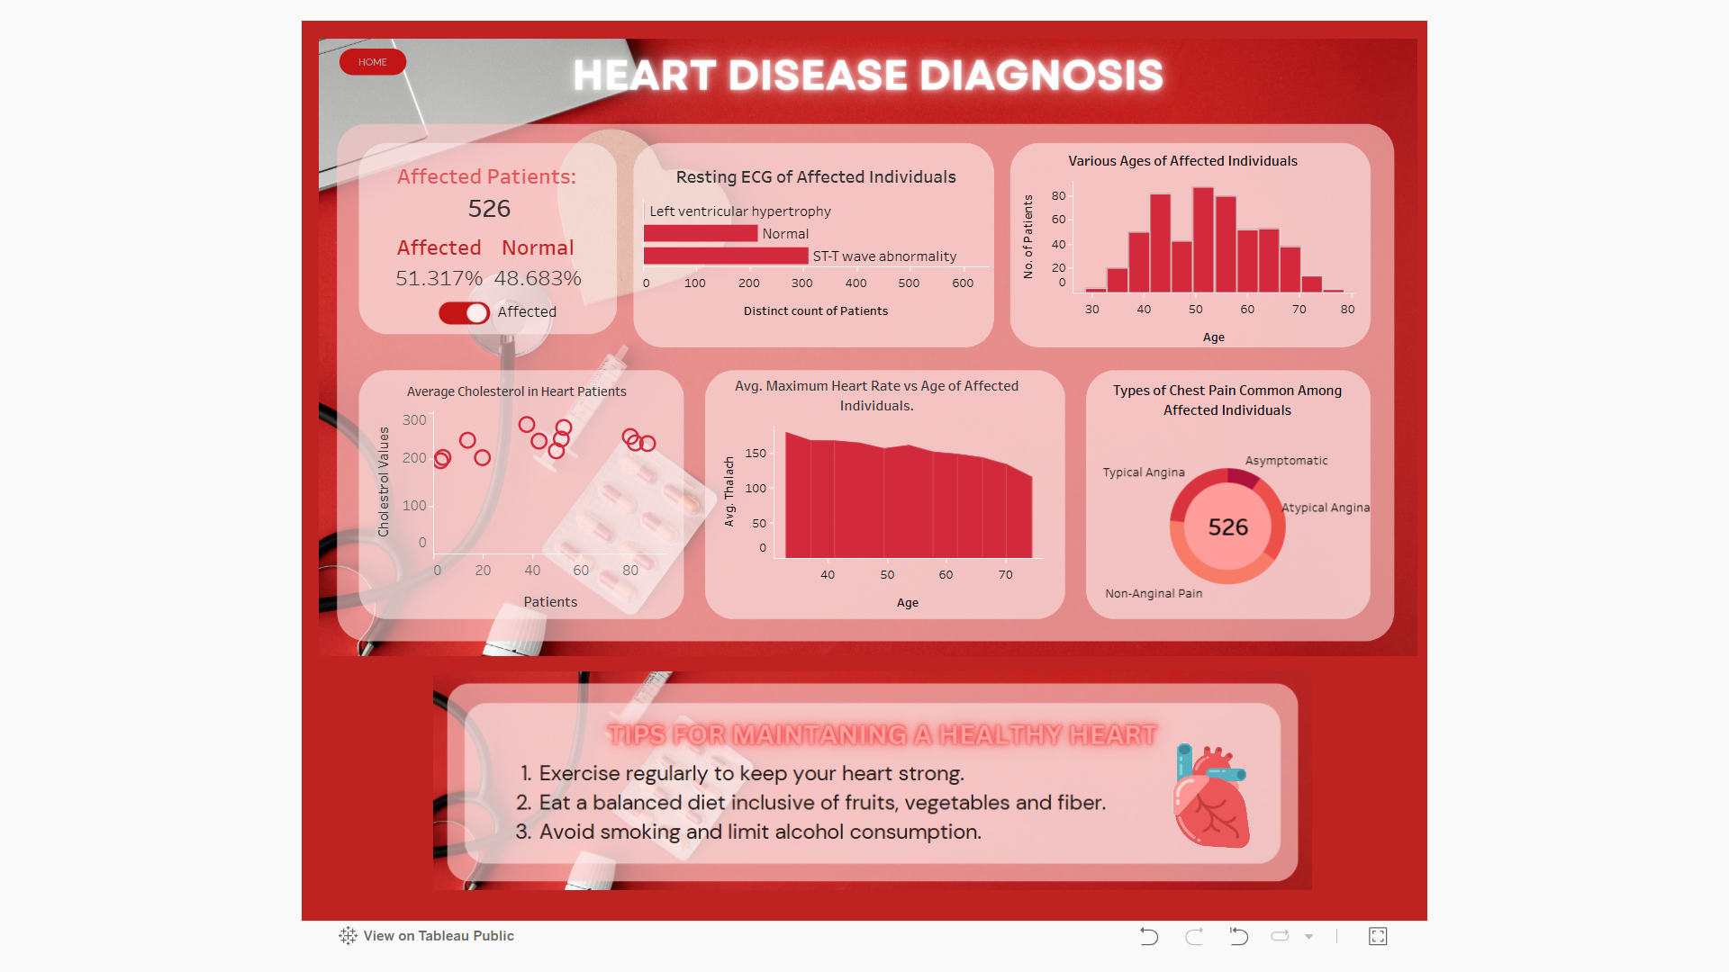
My Dashboard:

Slide 9
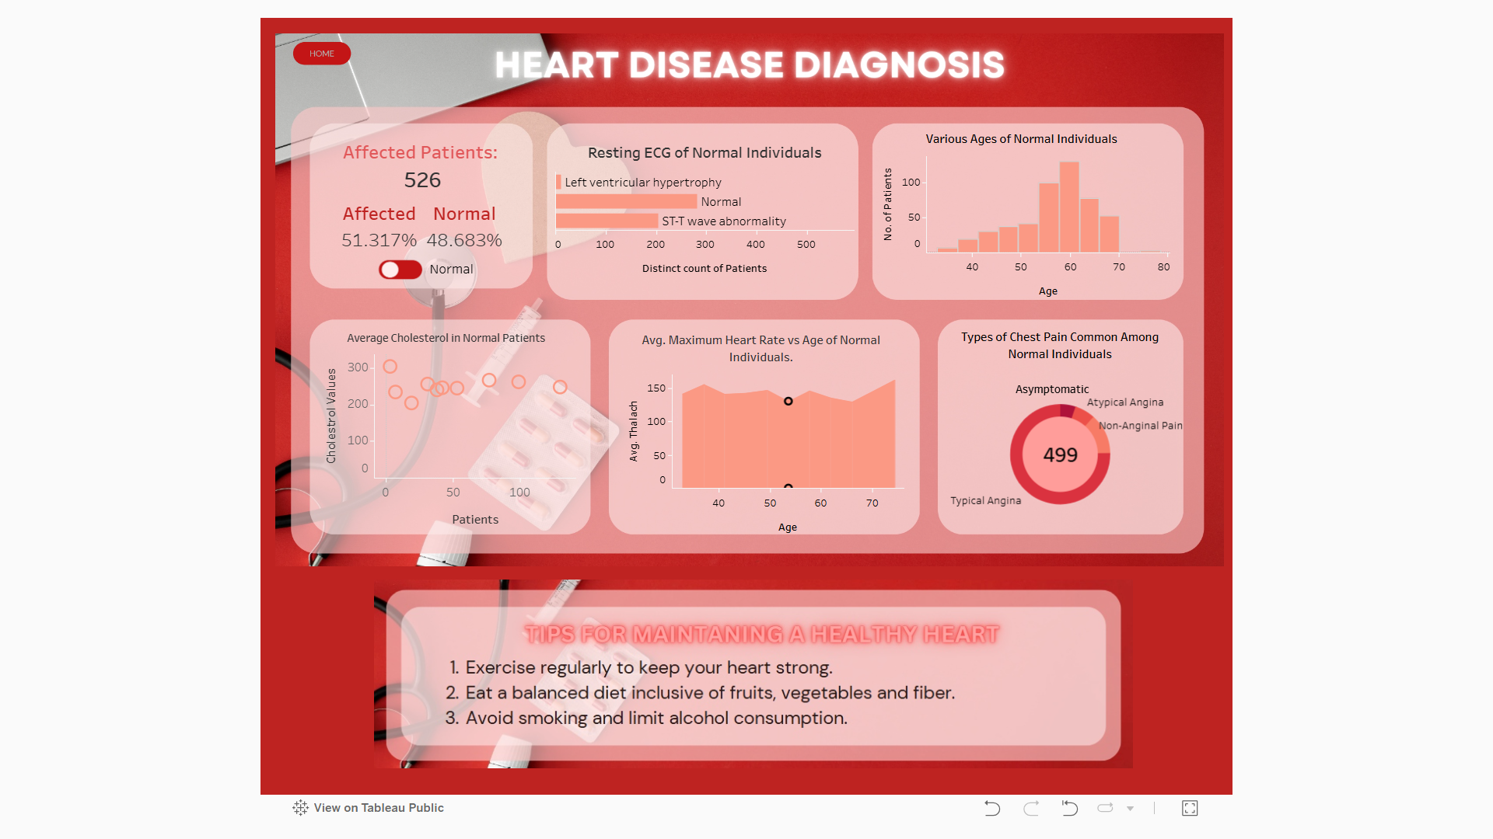
My Dashboard:

Slide 10
Links:
These are the links for the python and tableau project:
Python Project Github Link (Click)
Tableau Link (Click)

Slide 11
Conclusion:
Out of the 13 attributes that determine the target attribute, chest pain type (cp), number of major vessels (ca), maximum heart rate achieved during stress test (thalach), Thalium stress result (thal) and ST depression induced by exercise (oldpeak) prove to be the most influential factors.
The Random Forest Classifier Model has shown the highest accuracy with a score of 0.977, hence this model was choosen to experiment.
This heart disease diagnosis model can be used for various predictive analysis to obtain maximum accurate results.

